Slide 1
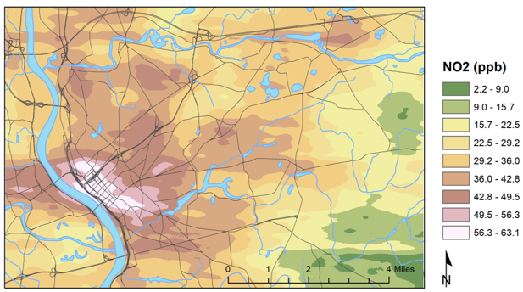
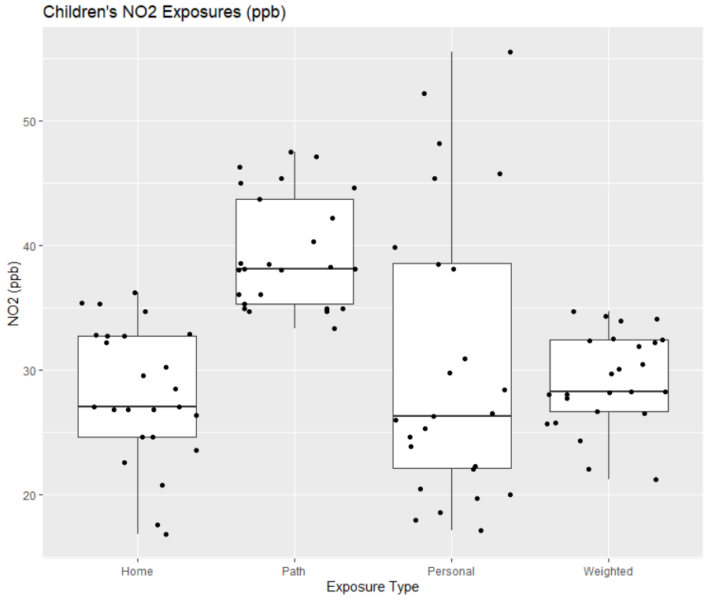
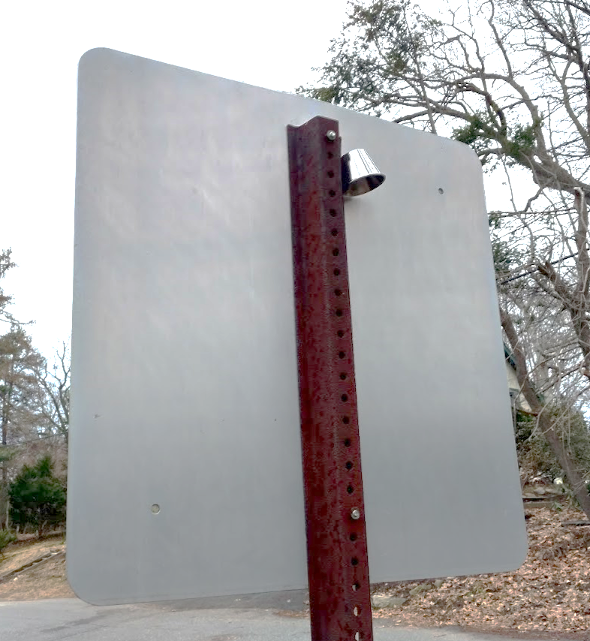
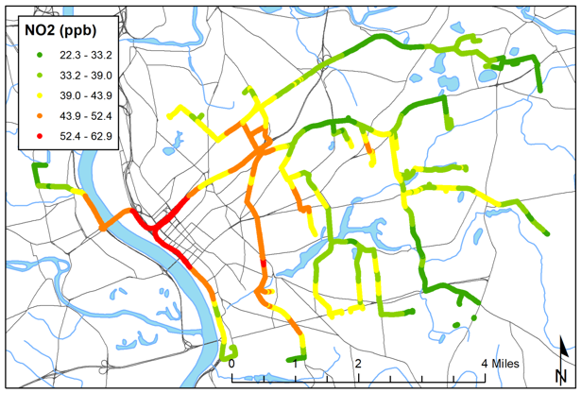
ASSESSMENT OF CHILDREN’S EXPOSURE TO TRAFFIC-RELATED AIR POLLUTION IN SPRINGFIELD, MASSACHUSETTS Sarah Esenther, Krystal Pollitt, Marianne Hatzopoulou, Laura Minet, Alexander De Jesus
ASSESSMENT OF CHILDREN’S EXPOSURE TO TRAFFIC-RELATED AIR POLLUTION IN SPRINGFIELD, MASSACHUSETTS
Sarah Esenther, Krystal Pollitt, Brian Leaderer
Introduction
Results
Outcomes
NO₂ is an indicator of traffic emissions, a known asthma trigger. While multiple air dispersion models, including the EPA’s C-LINE source model for roadway emissions, exist to estimate NO₂ exposures, it is hypothesized that discrepancies may exist between ambient and personal NO₂ exposures. The Fresh Air wristband (Fig 1), a silicone wristband housing a passive NO₂ sampler, allows for direct assessment of NO₂ exposure within vulnerable populations.
Land Use Regression Model
Children’s NO₂ Exposure Comparison
Fig 6. Boxplot comparisons of home, path, personal, and time-weighted exposures indicate that personal exposures had greater variation than estimated by land use regression modelling methods, especially for the students with the highest exposures.
Fig 3. Land Use Regression Model of NO₂ across the Greater Springfield area. Highest concentrations (white) of NO₂ were found in the downtown core while lowest levels (green) were found in neighboring towns.
50
40
A.
NO₂ (ppb)
30
Path, Personal, and Time-Weighted Exposures
20
Fig 1. (Above) A. Fresh Air wristband B. Interior contains PDMS bar and Ogawa NO₂ passive sampling pad
Fig 2. (Right) Magnetic sampler in protective housing deployed on street sign in Springfield, MA
Fig 4. Map of NO₂ exposures along children’s paths to school. Exposures were highest for commutes originating in the west and central regions of the city.
Home
Path
Personal
Time-Weighted
Exposure Type
Table 2. The path exposure was the only estimated exposure that correlated significantly with measured personal exposures. This likely due to the difference
 | Home | Path | Personal
Path | 2.15E-08 | - | -
Personal | 0.85 | 0.0043 | -
Weighted | 0.83 | 1.95E-09 | 0.50
between estimated home exposures (LUR outdoor estimates adjusted for indoor infiltration) and actual home exposures, which vary with conditions including stove type and hood usage. The weighted exposures likely did not correlate with personal exposures because of the influence of these home estimates, indicating the importance of home modifications to NO₂ exposure.
Methods
Personal Exposures
Fresh Air wristbands were deployed to a cohort of seventh grade students (n=25) at a charter middle school in Springfield with a 15.2% rate of asthma prevalence (2008-2009; MA average = 10.9%, national average = 8.4%). Children were surveyed about demographic and home characteristics as well as their transportation method and route to school to create time-weighted averages of NO₂ exposure for the five day period combining home, school, and path exposures (home and school exposures adjusted for infiltration rate to indoor environment).
The children’s exposures to NO₂ along their commute to school was highly dependent on their origin (home) location, ranging from 22.3 ppb to 62.9 ppb with an average commute time of 26.6 minutes (Fig 4). A comparison of the exposures indicates that most exposures were below that EPA Annual Exposure limit of 53 ppb (Fig 5).
Asthmatic Students | 7
Non-Asthmatic Students | 18
% Asthmatic Overall | 28%
% Asthmatic: Gas Stove | 46.2%
% Asthmatic: Other Stove | 8.3%
Table 3. While 28% of all students sampled were asthmatic, 46% of children living in homes with gas stoves had asthma.
Future Directions
Ambient Exposures: Land Use Regression Model
Pathway exposures extracted from the land use regression model may be used to inform school bus route selection to minimize pathway exposure of students to NO₂
The correlation between asthma and gas stove use in the home may be explored with a larger cohort
The same week, 40 Fresh Air wristbands were deployed across the greater Springfield area, encompassing the commute region of the students. Ninety three built environment and land use characteristics were collected for the area. The above parameters were selected by a forwards selection model and used to estimate NO₂ at 100m grid locations across the study area (Fig 3).
Limitations
Table 1. NO₂ predictors selected by backwards model (adj. R² = 0.73)
The small cohort size limits the power of the statistical power of the assessment of the correlation between the children’s exposures, home environments, and asthma
The land use regression model represents exposures only during the week of deployment, but other studies have observed seasonal variations in NO₂
Ambient NO₂ was measured as a 5-day average, but NO₂ levels during peak commute times when children travel to school may be higher
Land Use Regression Model Parameter | Coefficient
Length of roads within 1km (m) | 0.000759
Distance to nearest railline (m) | -0.00123
Building footprint within 1km (m²) | -3.03E-05
Area of institutional land within 1km (m²) | 9.24E-06
Fig 5. Comparison of the personal, home indoor, school indoor, and time-weighted averages of student exposures with the EPA Annual Standard for NO₂ (53ppb)
Funding/ acknowledgements
This work was funded by the UMass Public Service Endowment Grant.

