Slide 1
BBF-Ghana Committee Member Interviews
Qualitative Analysis Training
a technical assistance webinar
Cara Safon, MPH
Yale University
Yale University, New Haven, CT USA
August 11, 2017
1
Notes:
[Thank you + welcome]

Slide 2
BBF-Ghana Committee Member Interviews: Qualitative Analysis Training Agenda
1. Review in-depth interview objectives
2. Define key terminology
3. Walk through data analysis steps
4. Identify and prepare for next steps
http://www.meteo.gov.gh/website/
Notes:
In this training we will go over 4 important components of the BBF-Ghana committee member qualitative data analysis process
1) First, we will review the objectives of the in-depth interviews
2) Second, we will define key terminology to make sure we are all on the same page
3) Next, we will walk through each step in the data analysis process
4) Finally, we will identify and prepare for next steps post-analysis

Slide 3
BBF-Ghana Committee Member Interviews: Objectives
1. Conduct interviews with BBF committee members
2. Explain committee members’ experiences, lessons learned and key recommendations for decision makers
3. Evaluate and improve BBF process
Goals
Notes:
Now that we have developed the BBF Index methodology and pre-tested, the next step is to conduct an evaluation of the BBF process in Ghana
The committee member interview goals are 3-fold:
Via a qualitative study, conduct open-ended interviews with committee members
Understand and explain the committee members’ experiences in developing the BBF gears as well as their key recommendations for decision makers
Review and evaluate the BBF Process and contribute to its improvement

Slide 4
Qualitative v. Quantitative Research Design
Quantitative | Qualitative
Tests hypotheses | Examines perceptions, beliefs, and understanding of individuals or groups
Uses statistics to examine relationships between independent, dependent, moderating or mediating variables | Explores big research questions
Assesses breadth | Assesses depth
Deductive | Inductive
Notes:
It is important to reiterate some of the key differences between quantitative and qualitative research methodologies as we move forward in discussing analysis
Quantitative studies test hypotheses, while qualitative studies look at perceptions, beliefs, and understanding of people or groups of people
Quantitative studies use number to relate variables to one another, while qualitative explore big, general research questions
Quantitative studies seek to address breadth over depth, while the intention of qualitative is the opposite
Quantitative studies use deduction, moving from the general to the more specific, while qualitative studies move from specificity to generalization

Slide 5
Qualitative v. Quantitative Research Design
Quantitative | Qualitative
1 question | 1-2 main questions + 3-5 sub-questions + probes
Closed-ended survey questions | Broad, open-ended questions
Notes:
In quantitative studies, researchers try to answer one specific question; in qualitative studies, researchers begin with 1 or 2 big questions plus, sometimes, an addition few questions plus probing questions
With respect to the design of the questions included in each type of study, quantitative study data collection forms or research instruments include closed-ended survey questions, like multiple choice (Likert scale); T/F; or Y/N, while qualitative questions are open-ended, allowing the participant or participants to drive the direction of the data

Slide 6
Qualitative v. Quantitative Research Design
Quantitative | Qualitative
Survey | Ethnography
Observational | Grounded Theory
Experimental | Case Studies
- | Phenomenological Research
- | Ethical Research
Notes:
There are many different types of research designs
Quantitative:
Survey: like cross-sectional studies
Observational: like cohort or case-control studies
Experimental: like randomized controlled trials (RCTs) or quasi-experimental design
Qualitative
Ethnography: study conducted in participants’ natural setting
Grounded Theory: derivation of theory from participants’ own experiences
Case Studies: examination of participants’ experience with a particular program, event, or process, and usually involves different types of data collection
Phenomenological Research: analysis of particular phenomenon/event
Ethical Research: study related to ethics
These are just some examples of different types of qualitative and quantitative research designs. This research does not necessarily coincide well with any of these definitions. Because of this, we can call the committee member interview analysis a “thematic analysis”. This name explains well that we will be seeking themes in the interview data without assigning a specific type of research design name to it.

Slide 7
Qualitative v. Quantitative Research Design
What are some benefits of qualitative research?
Notes:
We’ve discussed many of the characteristics of qualitative research. What are some of the benefits?
[Wait for responses]
To understand perspectives
To explore ideas otherwise not necessarily represented in quantitative research
To probe in-depth about a particular issue
To address sensitive topics

Slide 8
Qualitative v. Quantitative Research Design
What are some qualitative research requirements?
Notes:
We’ve discussed many of the characteristics of qualitative research. What are some of the requirements?
[Wait for responses]
That the researcher establishes with the participant (during data collection):
Good rapport
Confidentiality
Trust
How is this done (during data collection)?
Maintenance of eye contact
Mirroring of responses
How is this done (after data collection)?
That the researcher systematically analyzes the data to produce high-quality results in order to respect the participant’s time and adhere to and respect the study’s rigor

Slide 9
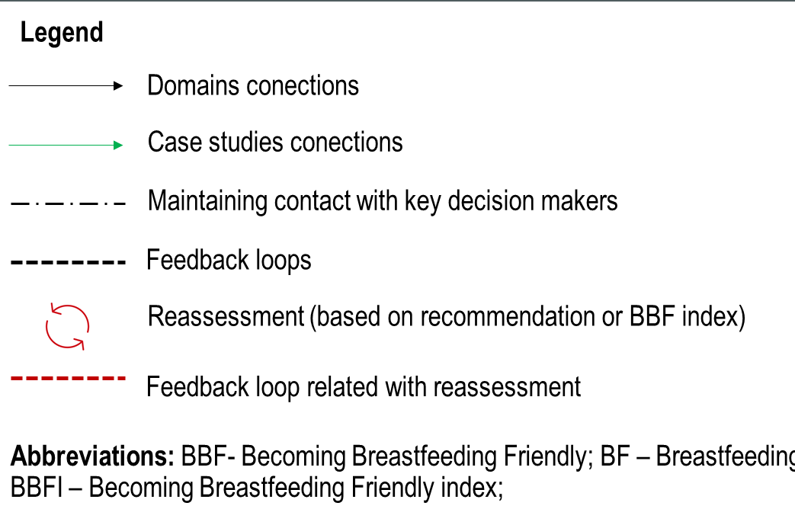
BBF Program Impact Pathways (PIP) Domains Explored with the BBF-Mexico Committee Member Interview Guide
Inputs
Process
Outputs
Outcome
Impact
BBF Score
Informed & prioritized recommendations
Implementation
BFGM gaps filled
Country’s commitment
Legislation, policy, funding monitoring & enforcement
Advocacy
Informing decisions makers and stakeholders
Political will
Improve breastfeeding outcomes
Dissemination of recommendations
Legislation & Policy
Committee formed
Mass media & social mobilization
Complete BBFI (meetings)
Funding & Resources
Policymaker’s reactions
Media coverage
Improve maternal & child health & nutrition
Committee trained
(meeting 1)
Training & Program Delivery
Increased country capacity (empowerment)
Promotion
Committee builds partnerships
Develop collective agenda and ideas (advocacy)
Research & Evaluation
Technical assistance/ training
Become a case study
Coordination, Goals & Monitoring
Case studies
Stronger enabling BF scale up environment
Before BBFI
During BBFI
After BBFI
Drivers & Assumptions
Committee motivation and effective teamwork
Sustainability
Ability to comprehensively acquire needed data
Dissemination to “right” people
High interactive process
Interaction with other public health programs
Committee understands BBF process and BBFI
Recommendations achievable & measurable
Strong country coordination allows for translation and enforcement of recs to action
Technical assistance/ training
Notes:
As you may remember, this is the Program Impact Pathways, or PIP for BBF
What I’m about to present on will reflect some of what was discussed during the recent TAG meeting, but to reiterate:
In designing the PIP, many factors were considered, including how stakeholders make decisions; what BBF committee governance would look like; and how recommendations to decision makers would be issued and implemented
Interview guide questions corresponding to these themes in the interview guide can be grouped into 3 broad sections: Questions asked about participants' experiences before assessing the BBFI, which correspond to most of the Inputs in the PIP; during the assessment of the BBFI, which correspond to most of the Process in the PIP; and after the assessment of the BBFI, which correspond to most of the Outputs in the PIP
The PIP is important to reflect upon as we consider the steps to be taken in the analysis of the committee member interviews because the PIP represents the BBF process and delineates the specific goals of 1) improving breastfeeding outcomes and 2) improving maternal and child health and nutrition.
It will be important to channel the PIP, and where the data may or may not fit in within the framework. This will allow us to identify bottlenecks, or critical quality control points, in the PIP and in the BBF process in order to improve the process moving forward and help other countries set a solid foundation as they begin the BBF process.

Slide 10
Qualitative Data Collection
During each interview
1. Obtain written informed consent
2. Audio-record the interviews
3. Note basic information about participant
4. Take additional notes about interview
Notes:
Now, you have already collected the data, thereby following the steps outlined here

Slide 11
Qualitative Data Collection
After each
interview
1. scan and upload interview notes
2. scan and upload informed consent
3. check audio files
4. submit audio file to transcriptionist
5. check for interview fluidity
6. compare original audio file against transcription to ensure accuracy
Notes:
An intermediate step between data collection and analysis includes the following:
[read each]

Slide 12
BBF-Mexico Committee Member Interviews
Name | Definition
Code | Name of tag assigned to interview excerpt representing an idea
Concept | Grouping of codes that express similar ideas
Category | Name for idea assigned to a group of concepts
Theme | Name for idea formed from basis of categories
Codebook | Data dictionary of codes used to help develop themes
Notes:
Before I continue with the description of the analytical methodology to be used, I want to define some key terms
A “code” is what I will call the name of a tag assigned to a piece of an interview that represents an idea (recurring or not)
A ”concept” is a group of codes that express similar ideas; some people call categories “buckets” into which you could “dump” the codes
A “category” is a group of concepts that forms the foundation for themes
A “theme” is a group of categories
A “codebook” is a data dictionary of codes, where our team will define the code, identify inclusion and exclusion criteria, provide an example, and use it to refer to codes across interviews

Slide 13
Qualitative Data Analysis: Steps
1. Read transcript
3. Establish consensus on codes
5. Develop draft codebook
2. Read + open-code transcript
4. Repeat steps 1-3 (10-20%)
6. Code transcripts using codebook
7. Refine codebook iteratively
Notes:
These four broad steps are those that we will follow in beginning to code and analyze the interview data; we will go over each one in detail in the following slides. Here is an overview:
Step 1. Read 1 transcript carefully
This step is particularly important for researchers who will be involved in the data analysis but who did not conduct the interviews themselves, so that they can familiarize themselves with the data before thinking about applying code
Step 2. Read more quickly and open-code transcript
Step 3. With at least one other researcher, discuss codes used among all researchers involved
Step 4. Repeat steps 1-3 until process has been completed for 10-20% of the interviews
Step 5. Develop a draft of the codebook using the initially developed codes (this can be done by the primary researcher)
Step 6. Repeat steps 1-3 using the draft codebook (this can be done by the primary researcher)
Step 7. Iteratively refine the codebook moving forward (this can be done by the primary researcher) and consider how to group them in order to
*It is not necessary to include more than the primary analyst in steps 5-7, though their input is welcome

Slide 14
Qualitative Data Analysis: Steps
1. Read transcript
3. Establish consensus on codes
5. Develop draft codebook
2. Read + open-code transcript
4. Repeat steps 1-3 (10-20%)
6. Code transcripts using codebook
7. Refine codebook iteratively
Notes:
Step 1

Slide 15
Qualitative Data Analysis: Steps
Step 1
Select and read a transcript
Consider big ideas
Take notes
Notes:
Step 1 consists of selecting and reading a transcript while thinking about big ideas that come out of the interviews
The researchers involved should be trained on qualitative research methodology and should participate in an agreed-upon methodology
This is important because QDA can take many forms and can be executed in many different ways; it is important that all researchers are on the same page as you move through each step
Those involved in this process should take notes on those as well as their observations and reactions; these notes can be taken in Microsoft Word in the interview transcript itself using the “comment” feature and even the “highlight” feature if doing so is helpful; some researchers also like to color code similar themes in order to organize their notes, for example
This process should be done with at least one other researcher but independently so that ideas can be vetted with one another afterward, but so that each researcher’s ideas or perceptions of the interview do not influence those of the other(s)

Slide 16
Qualitative Data Analysis: Steps
1. Read transcript
3. Establish consensus on codes
5. Develop draft codebook
2. Read + open-code transcript
4. Repeat steps 1-3 (10-20%)
6. Code transcripts using codebook
7. Refine codebook iteratively
Notes:
Step 2

Slide 17
Qualitative Data Analysis: Steps
Step 2
Apply codes to specific excerpts that represent ideas in the interviews to initiate a preliminary code list
Notes:
So, with respect to next steps, our plan is to apply codes – or tags – to specific excerpts that represent ideas in the text of the interview to initiate a preliminary list of codes

Slide 18
Types of Codes
Experience
Relating of a story by the participant
Relationship
Links between ideas participant shared
Perspective
Participant views of participant about a topic
Descriptive
Participant gender, age job, other role, age, etc.
Setting
Interview environment
A code is a label assigned to text
Notes:
At this point, you might be wondering: how do I begin the process of open-coding?
Though there are no set rules for types of codes researchers can or should use, it might be helpful to think about different types of codes that you can use to identify different pieces of the data
Remember that codes are labels that can be assigned to pieces of text within the interview transcript
(Codes should be short phrases or single words)
I list some examples of types of codes here. They include:
Experience
Relationship
Perspective
Descriptive
Setting

Slide 19
Qualitative Data Analysis: Steps
1. Read transcript
3. Establish consensus on codes
5. Develop draft codebook
2. Read + open-code transcript
4. Repeat steps 1-3 (10-20%)
6. Code transcripts using codebook
7. Refine codebook iteratively
Notes:
Step 3

Slide 20
Qualitative Data Analysis: Steps
Step 3
Establish consensus on codes, including usage and structure
Usage: when to use which codes
Structure: e.g., use of “parent” codes and “child” codes
Notes:
As I mentioned, the former steps should be done independently from other researchers involved in the data analysis process
Once the first transcript is coded, come together with colleagues and review the application of codes to agree on both usage and structure
When I say ”usage”, I am referring to the meaning of each code. Each researcher should use the same code – however that is spelled out or represented – for the same idea.
When I say “structure”, I mean the usage of big, general codes in tandem with smaller, more specific codes.
You may want to start out only using big or “parent” codes and move on later to include “child” codes when you decide how you would like to categorize your codes

Slide 21
Qualitative Data Analysis: Steps
What is the best way to come to build consensus?
Notes:
What are some of the ways that you have come to consensus in research in the past?
What are some lessons learned?
What are your suggestions?
Idea for reaching consensus about both code usage and structure:
It will be impossible for you use the same exact names for the codes in your transcripts as you code independently yet alongside your fellow researchers. However, you will often come up with similar ideas for codes. If they are similar enough and you can agree on a common name for the code to use in that instance and in future instances where the same idea comes up in the text in future interview transcripts, then you have established consensus about that code
If there are instances where one researcher assigns a code to an excerpt and the other(s) do(es) not, then you will want to discuss reasons for including or excluding that code there

Slide 22
Qualitative Data Analysis: Steps
1. Read transcript
3. Establish consensus on codes
5. Develop draft codebook
2. Read + open-code transcript
4. Repeat steps 1-3 (10-20%)
6. Code transcripts using codebook
7. Refine codebook iteratively
Notes:
Step 4

Slide 23
Qualitative Data Analysis: Steps
Step 4
Repeat Steps 1-3
Notes:
Steps 1-3 should be repeated for 10-20% of the transcripts in your dataset
For example, if you have 20 committee member interviews to analyze, then you will want to do the following for 2-4 transcripts:
1. Read the transcript
2. Re-read and open-code the transcript
3. Establish consensus on codes
Reading multiple transcripts will allow the research team to become exposed to more potential ideas, and therefore assign a wider variety of codes, to the data before the initiation of the development of the draft codebook

Slide 24
Qualitative Data Analysis: Steps
1. Read transcript
3. Establish consensus on codes
5. Develop draft codebook
2. Read + open-code transcript
4. Repeat steps 1-3 (10-20%)
6. Repeat steps 1-3 using codebook
7. Refine codebook iteratively
Notes:
Step 5

Slide 25
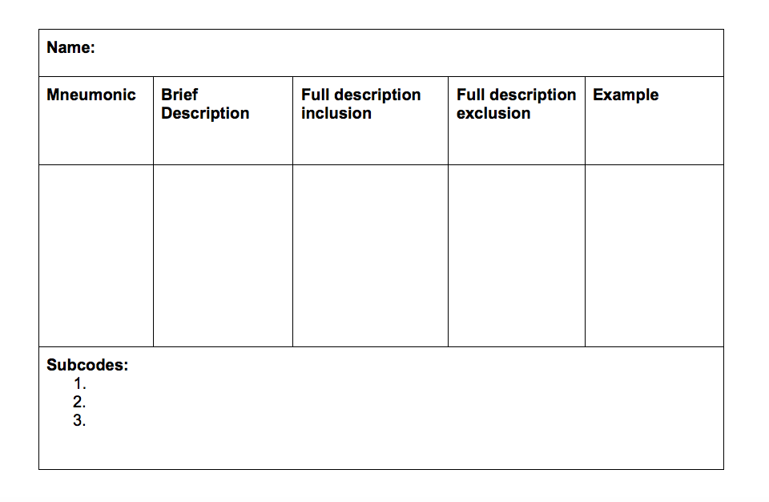
Qualitative Data Analysis: Steps
Step 5
Notes:
With the goal of developing a draft codebook, include the following:
The name of the code you would like to use
A mnemonic device – or an abbreviation - used to code excerpts quickly
A simple code definition
A short list of inclusion criteria
A short list of exclusion criteria
An example demonstrating the usage of the code – this example is a participant quote
Here is a template of a codebook that can be used
Some data analysis software programs – which I will discuss further later on in this presentation – can help you develop codebooks for you
Here is a template of the draft codebook you could create

Slide 26
Qualitative Data Analysis: Steps
1. Read transcript
3. Establish consensus on codes
5. Develop draft codebook
2. Read + open-code transcript
4. Repeat steps 1-3 (10-20%)
6. Code transcripts using codebook
7. Refine codebook iteratively
Notes:
Step 6

Slide 27
Qualitative Data Analysis: Steps
Step 6
Code subsequent transcripts using codebook
Notes:
Using your newly developed codebook as a reference, apply codes to the rest of the transcripts
This can be done by one person or by multiple people working together
The codebook can continue to be refined at this point, as the whole process is intended to be an iterative one

Slide 28
Qualitative Data Analysis: Steps
1. Read transcript
3. Establish consensus on codes
5. Develop draft codebook
2. Read + open-code transcript
4. Repeat steps 1-3 (10-20%)
6. Code transcripts using codebook
7. Refine codebook iteratively
Notes:
Which brings me to the next and final step, Step 7…

Slide 29
Qualitative Data Analysis: Steps
Step 7
Continue to refine codebook
Notes:
Using your newly developed codebook as a reference, apply the new, modified/refined codes to the transcripts coded independently by individual members of the team
Next, use the codebook to code the rest of the previously un-coded transcripts
This can be done by one person or by multiple people working together
The codebook can continue to be refined at this point, as the whole process is intended to be an iterative one
At the same time, you can begin to turn the codes into concepts, the concepts into categories, and the categories into themes
There is no right or wrong way to do this
What are some of your ideas that you have for doing this?

Slide 30
BBF-Ghana Committee Member Interviews: Qualitative Analysis Training
http://computermalaysia.com.my/atlasti.html
http://www.dedoose.com/
http://www.timberlake.co.uk/software/nvivo.html
http://www.maxqda.com/
Notes:
Although qualitative data analysis can be done without software, choosing the right program for you can help you ensure that the results of your analysis are of high quality
There are many different types of data analysis software to choose from
They all essentially perform the same functions which, are to categorize codes and ideas; generate queries so that the researcher is able to identify transcripts or excerpts within them more easily, and develop, add, subtract, combine and refine codes
These software programs also allow for another important function: the creation of memos
Memo development allows the analysts to record their observations or reactions to excerpts
This process can be done simultaneously to coding but is a separate concept and should not be grouped together with codes
However, QDA software programs do analyze data – the researcher(s) must do that

Slide 31
Qualitative Data Analysis: Next Steps
Presentation of Results
Discuss how themes might fit into the PIP or not
Discuss developing a conceptual model
Discuss applying the themes to another existing framework
Discuss writing of manuscript
Notes:
Now that you’ve coded the data, the next step in the analysis process consists of deciding what to make of the codes
You could talk about how the themes you’ve developed do or do not fit into the PIP, and discussing reasons for that outcome
You could develop your own mini conceptual model based on the themes that arose from the data
You could apply the themes to another existing framework, if it fits
You should talk about publication and dissemination of results

Slide 32
Qualitative Data Analysis: Next Steps
Presentation of Results
Describe specific methodology used
Consider academic and cultural context of findings
Describe why the findings are important/the contributions to the literature
Apply results to policy and/or practice
Notes:
You might now be wondering what to do after the data analysis is complete
Keep in mind that QDA is time consuming, and it is likely to take longer than quantitative data analysis
An appropriate next step might include preparing the results for a manuscript; if so, you will want to make sure you do the following:
Describe the specific methodology that you used in preparing, coding and analyzing the data
Consider the academic and cultural context of your findings

Slide 33
Acknowledgements
With approval from Dr. Emily Bucholz and the YSPH Global Health Concentration Director, some of the content included in this presentation has been adapted from slides presented at the Yale School of Public Health (YSPH) Down’s Fellowship Workshop delivered by Dr. Bucholz on December 3 and 10, 2014
Thank you for your participation!
Notes:
[Read]

Slide 34
Additional Qualitative Analysis References
Background reading
Corbin and Strauss, The Basics of Qualitative Research, 4th Edition, 2014
Creswell JW. Chapters 4 & 5 In: Research Design: Qualitative and quantitative approaches, Thousand Oaks, CA, Sage Publications, Inc.
Lincoln, YS. Sympathetic Connections between Qualitative Methods and Health Research.
Analytic software user guides
Atlas.ti User Guide and Reference: http://atlasti.com/wp-content/uploads/2014/05/atlasti_v7_manual_201312.pdf?q=/uploads/media/atlasti_v7_manual_201312.pdf
Dedoose User Guide: http://www.dedoose.com/userguide
MAXQDA 12 Reference Manual: http://www.maxqda.com/download/manuals/MAX12_manual_eng.pdf
NVIVO 10 Getting Started Guide: http://download.qsrinternational.com/Document/NVivo10/NVivo10-Getting-Started-Guide.pdf
Notes:
If you are looking for additional resources on qualitative research or qualitative data analysis, here is a list of some

Slide 35
Questions?
https://www.pinterest.com/pin/506092076855078838/
Cara.Safon@yale.edu
Notes:
Thank you + questions

