Slide 1
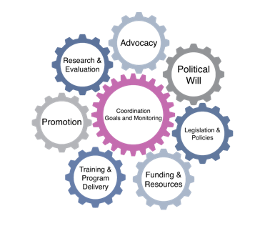
Becoming Breastfeeding Friendly (BBF)
Brief Development Guidance
Part II. Infograph Content + Design
1
Notes:
Now, we are going to discuss BBF Infographs

Slide 2
Objectives
Review Aims of BFF Infographs
Describe Contents of BBF Infographs
Notes:
First I will review the aims of the BBF infograph
Then. I will describe what goes on the BBF infograph

Slide 3
Key Aspects of Different Briefs
Type of brief | Length | Aim | Potential audience | When to prepare? | When to use?
Policy 1-pager | up to 2 pages | Engage stakeholders | Stakeholders | Between 1st and 2nd meeting | Throughout the 5-meeting process and beyond
Infograph | 1 page | Disseminate policy recommendations and summarize all policy evidence | Stakeholders; general public | Between 4th and 5th meetings | By 5th meeting and beyond
Policy brief | up to 4 pages | Disseminate prioritized recommendations | Policymakers, journalists, senior advisers to policymakers | Between 4th and 5th meetings | By 5th meeting and beyond
Adapted from: Wong SL, Green LA, Bazemore AW, Miller BF. How to write a health policy brief. Families, Systems, & Health. 2017 Mar;35(1):21. 7
Notes:
As Cara has mentioned, there are many different types of briefs that communicate policy ideas or proposed actions. I will be presenting on what goes into making an infograph in the context of BBF.
The BFF inforgraph is a one page document whose purpose is to disseminate policy recommendations and summarize all policy evidence for stakeholders and the general public
This will be prepared between the 4th/5th meeting and will be used both at and after the 5th meeting

Slide 4
1-pager
Infograph
Dissemination strategies
+ Policy Brief
1st
Meeting
2nd
Meeting
3rd
Meeting
4th
Meeting
5th
Meeting
Suggested BBF brief development timeline
Notes:
As just described, the infograph will be developed between the 4th/5th meeting and used during and after the 5th meeting as it can be used to communicate recommendations developed by your countries' committee.

Slide 5
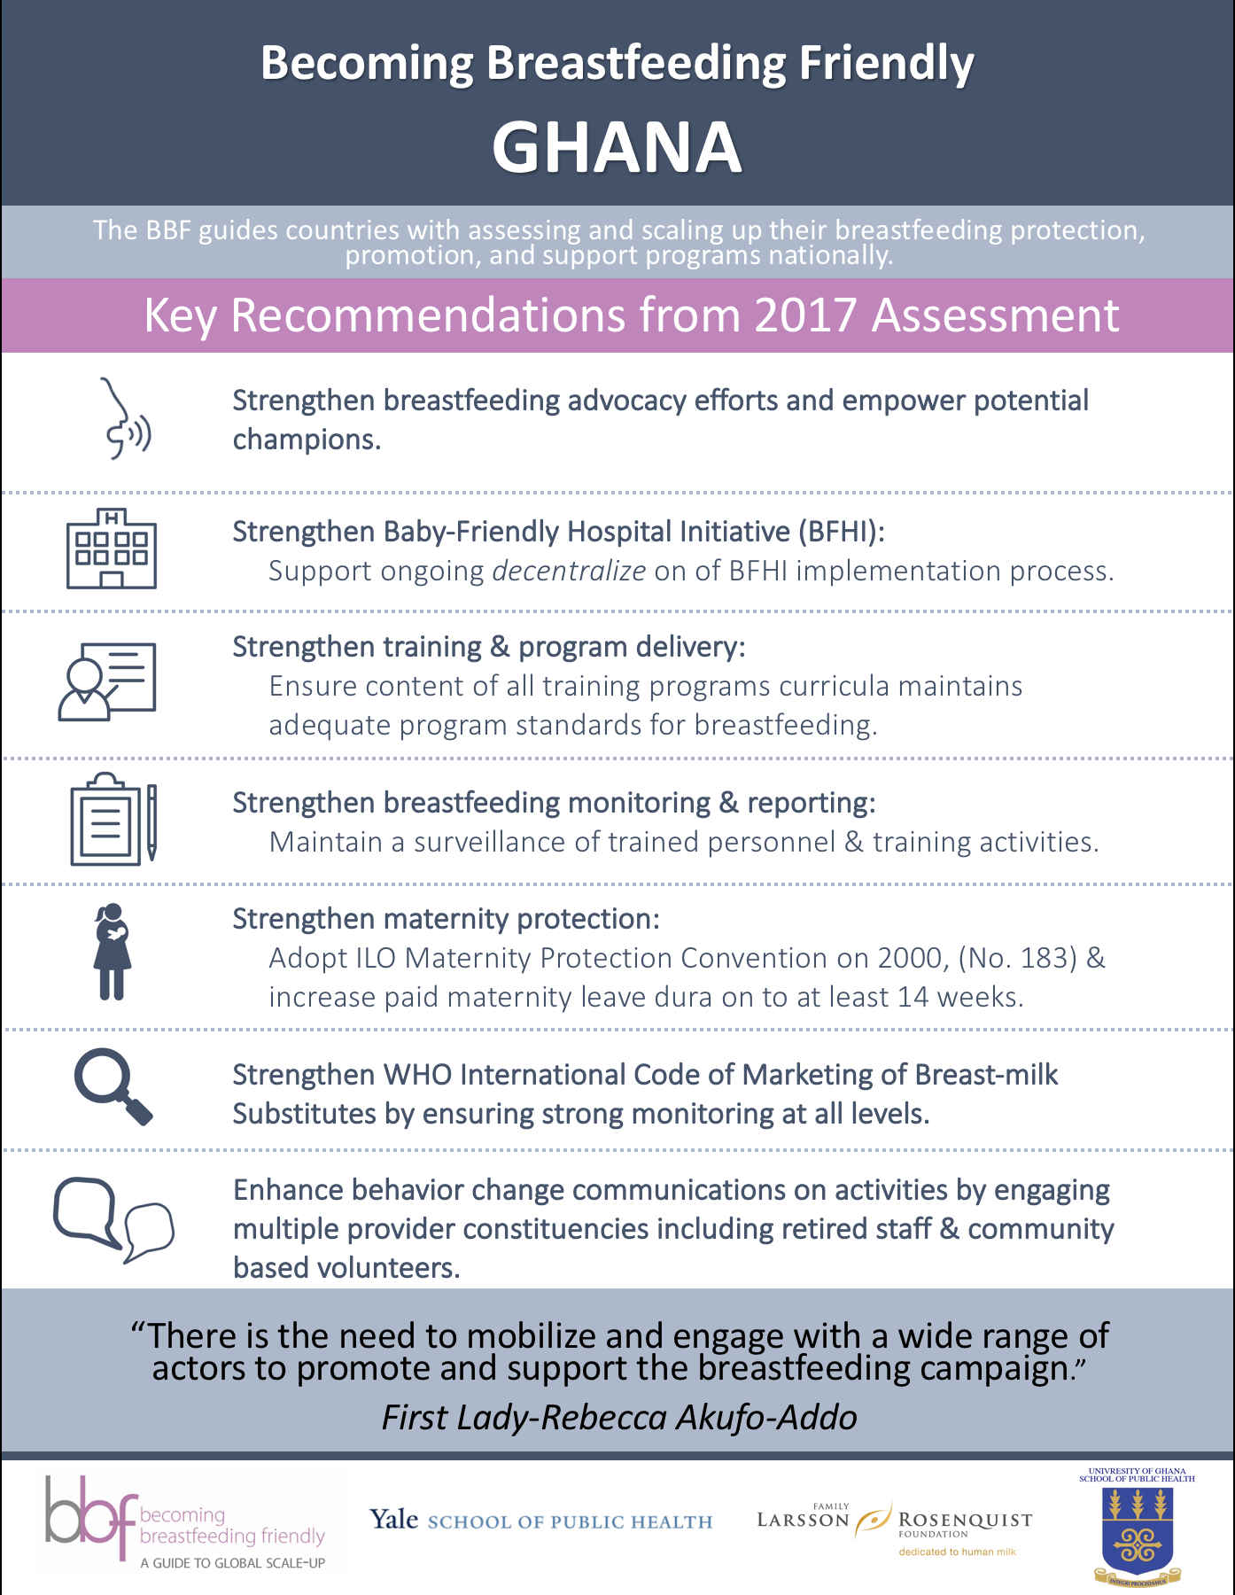
Aim of BBF Infograph
One page document
Disseminate policy recommendations to general population in given country.
Notes:
General Aim of Infographs
Communicate a clear message and that simplify information for a general audience.
BBF Aim of Infographs:
Disseminate policy recommendations to general population in given country.

Slide 6
Objectives
Review Aims of BFF Infographs
Describe Contents of BBF Infographs

Slide 7
Brief Explanation of BBF
Priority
Recommendations
Key Message or Quote
Notes:
The first part of the infograph should provide a brief explanation of BBF.
This document should be able to stand alone from any other BBF document
The second part of the infograph includes a Committee’s Top or Priority Recommendations to improve the breastfeeding environment and outcomes within your country:
Make sure to define key terminology, interventions, and policies so they are understood by general population
The third part of the infograph contains a key take away message or strong quote that summarizes the importance of this work
**I will discuss where you can find icons in the branding & design slide set

Slide 8
Infograph Example & Template
Notes:
We have provided an example of an infograph and template that can be used
As stated before, this template should be modified to meet your countries needs and priority recommendations included on the inforgraph

