Slide 2
Advocacy Gear
Meeting 2 presentation
Gear Team Members:
March 2018

Slide 3
AG1: There have been major events that have drawn media attention to breastfeeding issues.
This benchmark measures whether any media attention has been drawn to breastfeeding problems, concerns, or issues through major events to advocate for breastfeeding and, if so, how much media attention has been garnered. Major events can include conferences, gatherings, reports, photos, TV ads, or planned events to galvanize public attention towards advocating for breastfeeding

Slide 4
AG1: There have been major events that have drawn media attention to breastfeeding issues.
No progress has been made if there have not been any major events that have drawn national media coverage to breastfeeding issues that galvanizes public attention towards advocating for breastfeeding.
To achieve minimal progress, has been made if there has been one major event that have drawn national media coverage to breastfeeding issues that galvanizes public attention towards advocating for breastfeeding.
To achieve partial progress, has been made if there have been two major events that have drawn national media coverage to breastfeeding issues at different times during the year that galvanize public attention towards advocating for breastfeeding.
To achieve major progress, has been made if there have been three or more major event that have drawn national media coverage to breastfeeding issues at different times during the year that galvanizes public attention towards advocating for breastfeeding. Because BBF is perceived as an ongoing process the word "progress" is used in the scoring. For the first application of the BBF (i.e. the first BBF assessment), if chosen, the scoring terminology can be changed (e.g. not achieved, minimally achieved, partially achieved, fully achieved) to reflect the first application. For BBF reassessments, the wording will need to be revised back to the original scoring terminology "no progress, minimal progress, partial progress, and major progress".

Slide 5
AG1: Methodology used for data collection
E.g. if it was an interview (who they interviewed and asked), a media study (what media they looked for and what keywords they searched for), a document review (what documents they reviewed)

Slide 6
AG1: Findings
Summary of what was found from the data collected

Slide 7
AG1 Proposed Score: SCORE
Major events:
Conferences
Gatherings
Reports
Photos
TV ads
Anything planned that galvanizes advocacy

Slide 8
AG1: Gaps and recommendations
Gaps
Gap 1
Gap 2
Etc.
Recommendations
Recommendation 1
Recommendation 2
Etc.

Slide 9
AG2: There are high-level advocates or influential individuals who have taken on breastfeeding as a cause that they are promoting
This benchmark assesses whether there are champion(s) that have publicly been promoting breastfeeding as an important cause for the country. The champion(s) can be non-governmental high-level advocates or influential individuals who are highly visible people, are seen frequently (at least 3 times within the year) promoting breastfeeding, and/or who are recognized/respected people whose opinions are valued and generate advocacy. These individuals can include traditional, religious, social leaders, public figures, social media

Slide 10
AG2: There are high-level advocates or influential individuals who have taken on breastfeeding as a cause that they are promoting
No progress has been made for this benchmark if there are no high-level advocates or influential individuals who have taken on breastfeeding as a cause that they are promoting.
Minimal progress has been made if there is only one high-level advocate or influential individual who has taken on breastfeeding as a cause that he/she is promoting.
Partial progress has been made if there are two high-level advocates or influential individuals who have taken on breastfeeding as a cause that they are promoting, then progress is partial.
Major progress indicates that there are three or more high-level advocates or influential individuals who have taken on breastfeeding as a cause that they are promoting.

Slide 11
AG2: Methodology used for data collection
E.g. if it was an interview (who they interviewed and asked), a media study (what media they looked for and what keywords they searched for), a document review (what documents they reviewed)

Slide 12
AG2: Findings
Summary of what was found from the data collected

Slide 13
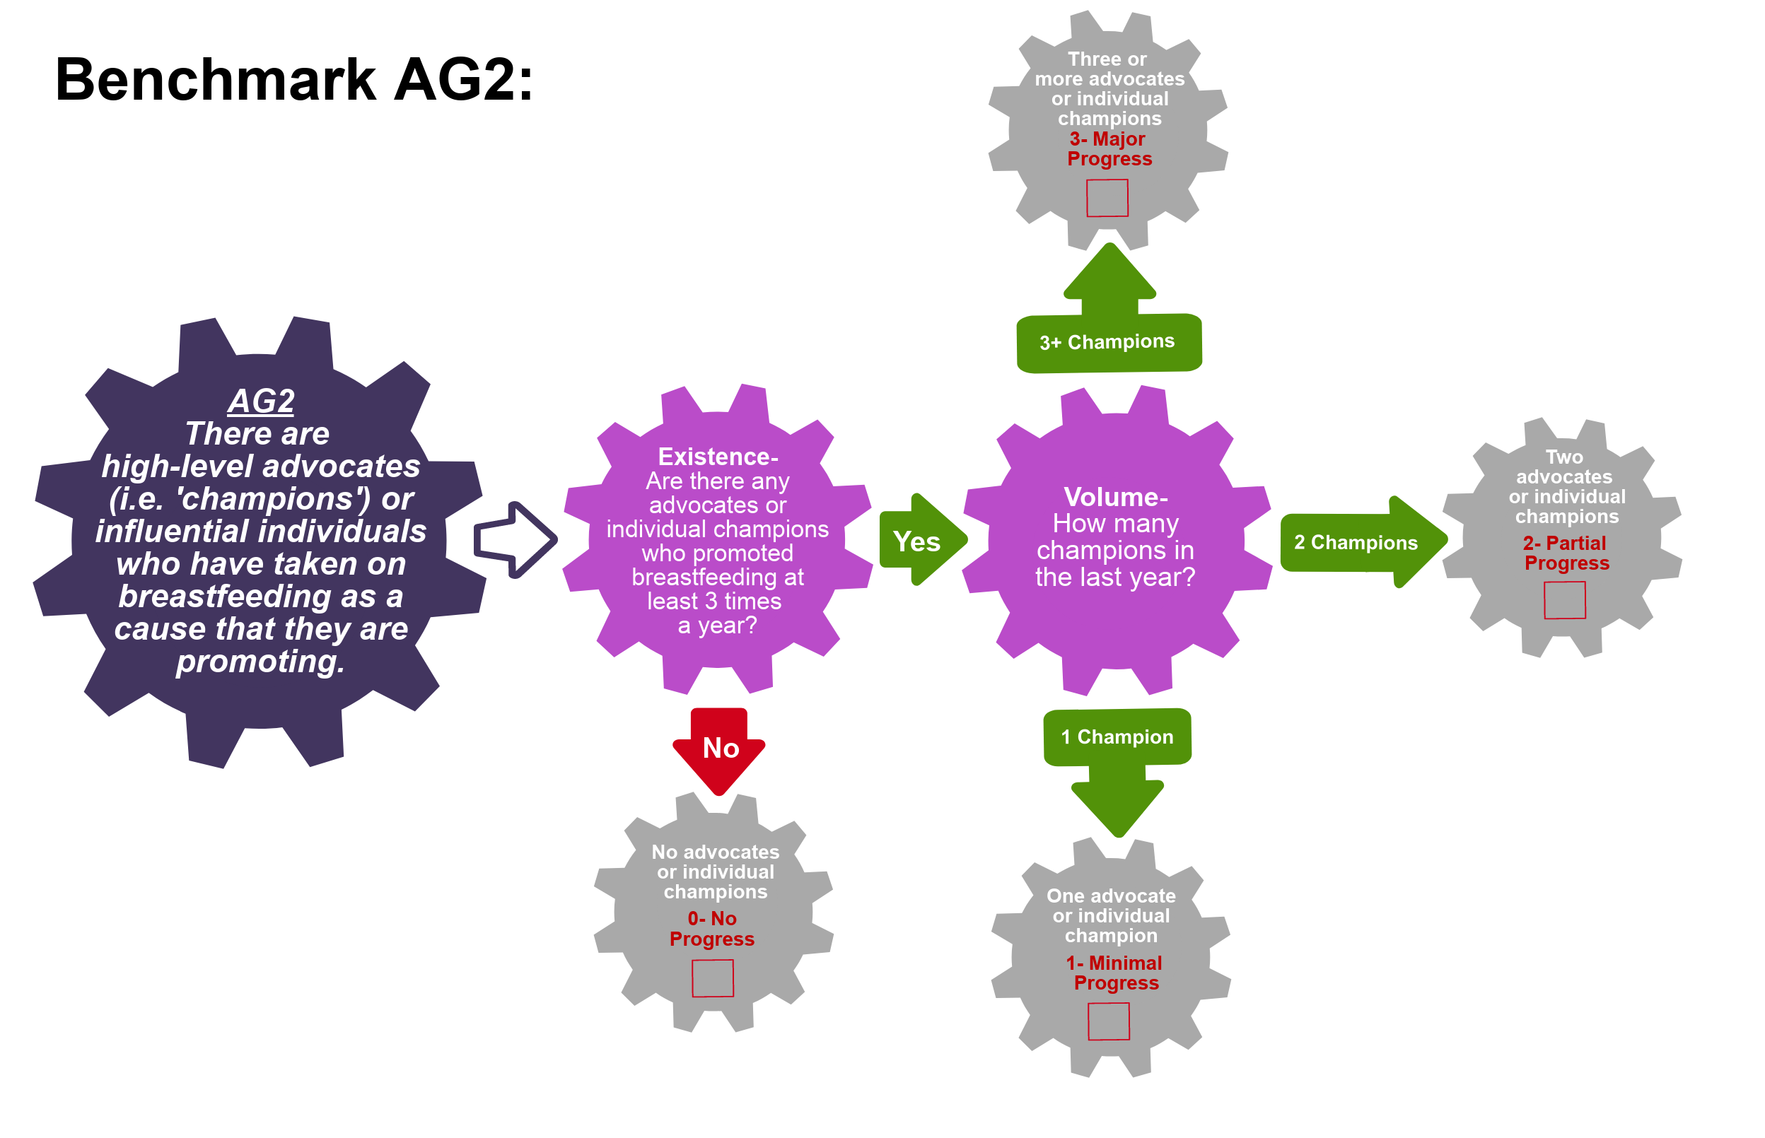
AG2 Proposed Score: SCORE
High level advocates or “Champions”:
Non governmental
Influential & highly visible
Often seen promoting causes
Recognized/respected people with valued opinions

Slide 14
AG2: Gaps and recommendations
Gaps
Gap 1
Gap 2
Etc.
Recommendations
Recommendation 1
Recommendation 2
Etc.

Slide 15
AG3: There is a national advocacy strategy based on sound formative research.
This benchmark evaluates the presence and content of a national advocacy strategy. A national advocacy strategy is a governmental or non-governmental document or initiative that aims to organize and/or systematize breastfeeding advocacy actions within the country. If a national advocacy strategy exists then it must be based on sound formative research. Formative research helps to systematically understand characteristics, needs, preferences, etc. of different communities to then effectively build strategies and interventions. Sound formative research is grounded in theory and the country’s context. A national advocacy strategy should be based on the country-level characteristics and needs.

Slide 16
AG3: There is a national advocacy strategy based on sound formative research.
No progress has been made if there is no national advocacy strategy.
Minimal progress has been made if there is a national advocacy strategy but it is not based on sound formative research.
Partial progress has been made if there is a national advocacy strategy that is based on sound formative research but it is not effective (i.e. operational).
Major progress has been made if there is a national advocacy strategy that is based on sound formative research and it is effective (i.e. operational).

Slide 17
AG3: Methodology used for data collection
E.g. if it was an interview (who they interviewed and asked), a media study (what media they looked for and what keywords they searched for), a document review (what documents they reviewed)

Slide 18
AG3: Findings
Summary of what was found from the data collected

Slide 19
AG3 Proposed Score: SCORE

Slide 20
AG3: Gaps and recommendations
Gaps
Gap 1
Gap 2
Etc.
Recommendations
Recommendation 1
Recommendation 2
Etc.

Slide 21
AG4: A national cohesive network(s) of advocates exists to increase political and financial commitments to breastfeeding.
This benchmark assesses the presence or absence of a cohesive network(s) of advocates that specifically works to increase political and financial commitments to breastfeeding. A network is formed by two or more advocate organizations and is considered cohesive when they work collectively. The network activity must be proportional to its coverage (national, subnational, and/or local). The network needs to include breastfeeding advocacy as a key focus, but it does not need to be the only advocacy issue it defends.

Slide 22
AG4: A national cohesive network(s) of advocates exists to increase political and financial commitments to breastfeeding.
No progress has been made if there is no national cohesive network(s) of advocates to increase political and financial commitments to breastfeeding.
Minimal progress is achieved if a national cohesive network(s) of advocates exists to increase political and financial commitments to breastfeeding but only to a limited extent (i.e. they only have local coverage).
Partial progress is achieved if a national cohesive network(s) of advocates exists to increase political and financial commitments to breastfeeding to some extent (i.e. they have subnational coverage).
Major progress is achieved if a national cohesive network(s) of advocates exists to increase political and financial commitments to breastfeeding nationwide.

Slide 23
AG4: Methodology used for data collection
E.g. if it was an interview (who they interviewed and asked), a media study (what media they looked for and what keywords they searched for), a document review (what documents they reviewed)

Slide 24
AG4: Findings
Summary of what was found from the data collected

Slide 25
AG4 Proposed Score: SCORE
Advocacy groups working collectively and cohesively to increase breastfeeding commitments

Slide 26
AG4: Gaps and recommendations
Gaps
Gap 1
Gap 2
Etc.
Recommendations
Recommendation 1
Recommendation 2
Etc.

